Slide 1

Case Study
Apple & CSR
BBA 1st SEM (2022-23)
Submitted By-
Shankh Bansal
AU22C1013
Submitted To-
Dr. Meenal Sharma

Slide 2

Steve Paul Jobs
Image of the distinctive, individualistic silicon valley entrepreneur.
Emphasizing the importance of design and aesthetics.
His work is driving forward the development of product that are both functional and elegant.
Jobs is listed as either primary inventor or co-inventor in over 230 awarded patents.
Known for his innovation & charismatic nature.

Slide 3
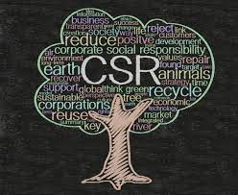
Corporate social responsibility
Self working conditions.
Treat workers with dignity and respect.
Use environmentally responsible manufacturing processes.
Disclosure of information.
Protection of intellectual property.

Slide 4

Supporting local communities and empowering workers
Global volunteer program was launched to encourage employees to volunteer in local communities.
Apple education and development program is offered free of charge by 18 factories and more than 280000 workers took various courses.
And contribute through their own individual experiences.
Because this environment inspire creativity and innovations.
And empowers us all to do the best work of our lives.
Together.

Slide 5

Labour & human rights
Apple enforces the supplier code of conduct that is claimed to be the toughest in the electronics industry.
Company has achieved an average 95% compliance among suppliers to maximum 60-hours workweek.
Apple has investigated cases of abuses of foreign workers and the company has required suppliers to reimburse affected “foreign contract workers US$3.9 million in excessive fees paid to labour brokers, bringing their total reimbursements since 2008 to US$16.9 million”

Slide 6
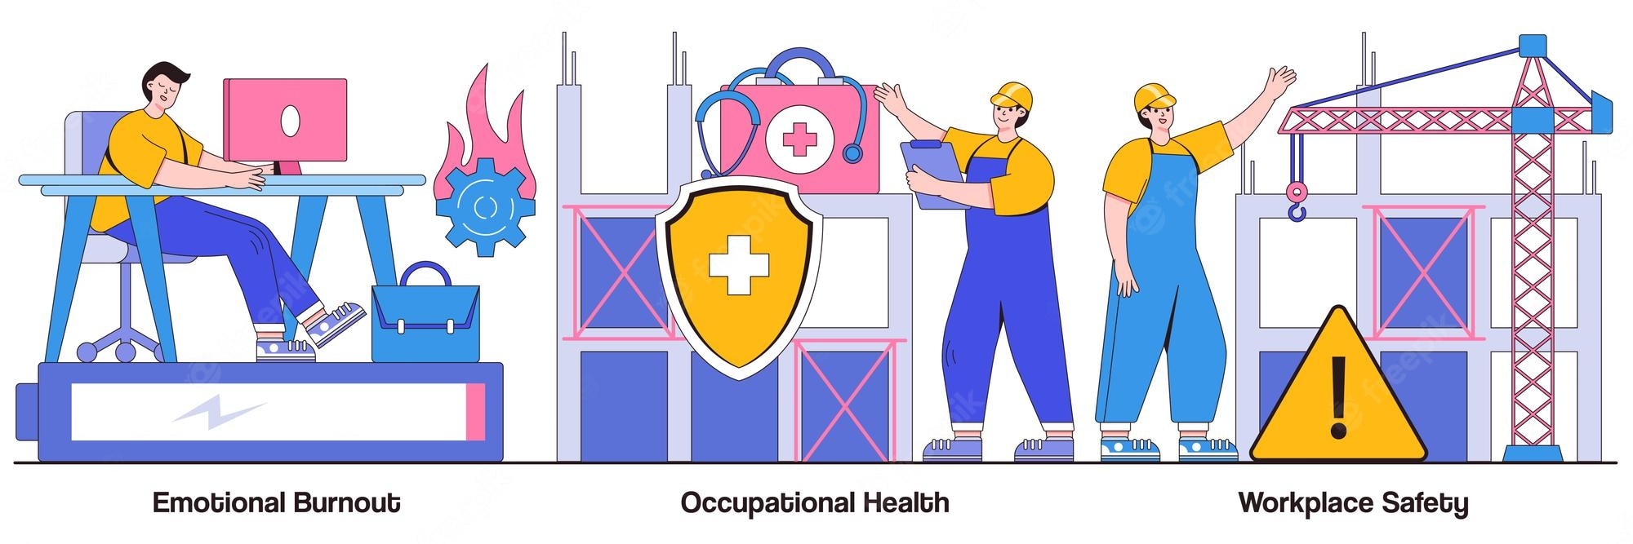
Employee health and safety
The company has launched apple supplier EHS academy, an 18 month program that aims to improve employee heath and safety in the industry throughout the globe. 240 suppliers and 270000 workers have participated in this program.
Research has been conducted in apple ergonomics department on about 75 jobs within supply chain to identify ergonomics risks. The research has resulted in improved standards for managing workstation design changes.

Slide 7

Energy consumption
Apple is often praised for its environmental records that includes decrease of total power consumption of apple products by 57%, introducing of mac mini as the worlds most energy efficient desktop computer and exceeding ENERGY STAR guidelines.
Apple emerges as the only company that has been awarded with a clean energy index of 100% according to green peace.
As of 2014, 100% of apple operations in the US and 87% of global operations are powered by renewable energy.

Slide 8
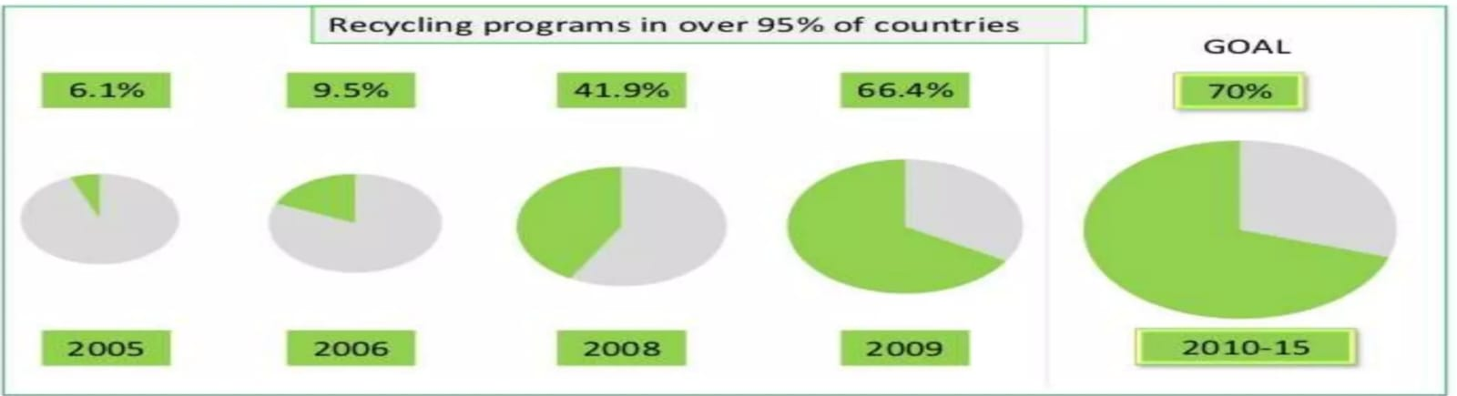
Recycling
Apple offers recycling programs in 99% of the countries it operates and the company has diverted more than 508 million pounds of electronics waste from landfills since 2008.
Recycling focus begins at very design stage to use less and recyclable material.
The MacBook battery can be charged up to 10000 times and composed up to 200-300 times for other notebooks

Slide 9
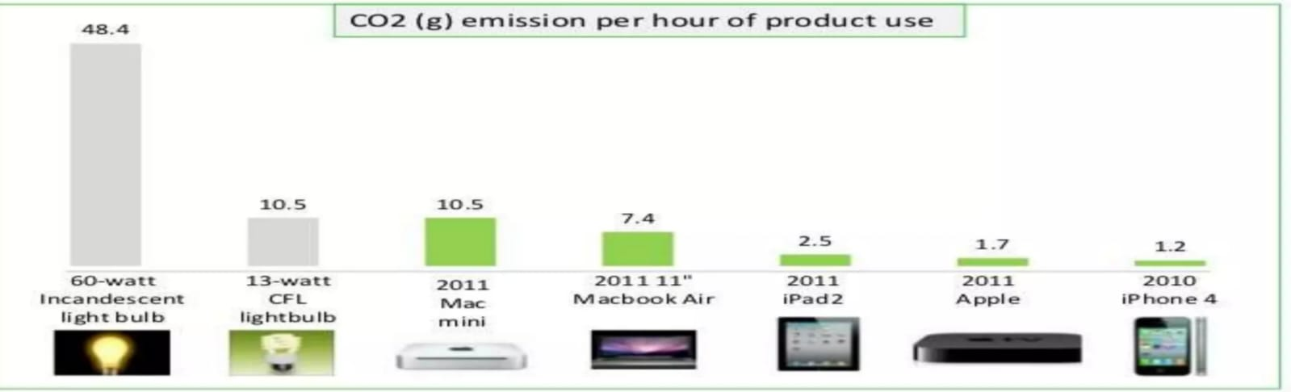
CO2 Emission
The company offers employee more than 550 electric vehicle charging ports for free, an increase of 67% compared to previous year to encourage usage of e vehicles.
the company CO2 emission has been continues decline during the last four years reach 114.2 kg.
Mac mini uses even less power than a 13 watt lightbulb, making it the most energy efficient desktop in the world.

Slide 10

Key takeaways
Apple Inc. is an American multinational technology company that designs and manufactures personal computers, smartphones, tablet computers, computer peripherals, and computer software.
Currently, Apple is the largest information technology company by revenue and the world's most valuable company.
Apple's business conduct includes four main principles that guide its business practices: honesty, respect, confidentiality and compliance.
Apple's actions regarding CSR include creating learning opportunities, ensuring health & safety , and protecting the environment.
Unfortunately, there seem to be several ethical issues with Apple such as poor working conditions such as health & safety risks, child labor, poor environmental reporting, contributing to e-waste and tax avoidance.

Slide 11

Conclusion
If they want to remove the allegations of violation of CSR policies, then they have to satisfy their stakeholders first. Because if they follow the ethical code of conduct, they will automatically not face CSR challenges.
Apple is responsible for the alleged human rights violations. It is Apple’s duty to ensure that fair labor practices are followed by their suppliers also. They should ensure that the supplier should declare that they will follow fair labor practices as part of their contract. They will have to maintain close coordination with all their suppliers to ensure that their suppliers’ labor practices are fair. It has keep an eye on what labor practices are followed by its suppliers as Apple itself is indirectly responsible for that also.

